Slide 1


Predicting IMDb Movie Ratings
Group 6
Group 6: Adegbenga Ayoola, Grace Le, Michelle Raj, Syed Bari, Wardah Anis

Slide 2

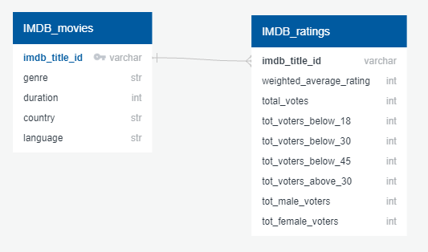
ABOUT DATA
Data Source | Kaggle (IMDB Dataset)
Data Points | 85855
Target | weighted_average_rating
Features | Duration Country Language Tot_voters_below_18 Tot_voters_below_30 Tot_voters_below_45 Tot_voters_above_45 Tot_male_voters Tot_female_voters
Figure 1: ERD Diagram

Slide 3
SUMMARY
Merged Data (Python)
Data Cleaning (Python)
Encoding Data (Excel and Python)
Preprocessing Data for Machine Learning (Python)
Linear regression
Support Vector Machine
Random Forest regression
Gradient Boosting
Deep Learning
Train
Fit
Accuracy Scores & Confusion Matrix

Slide 4
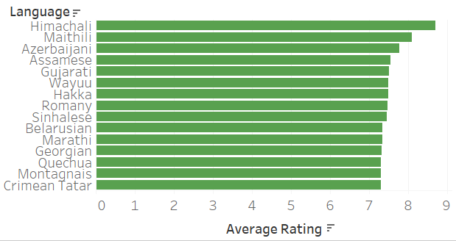
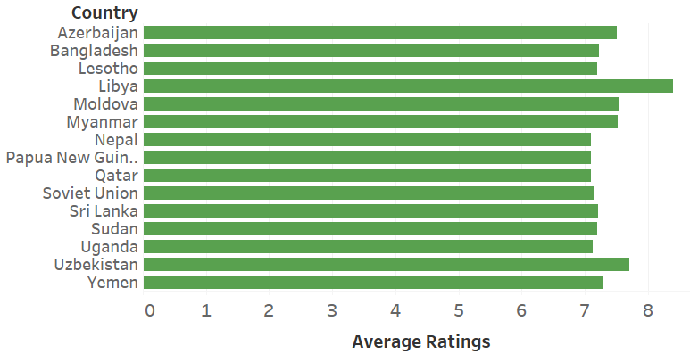
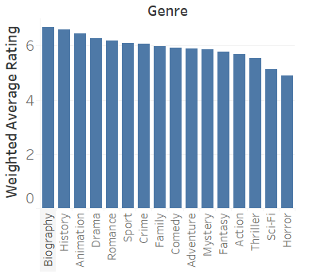
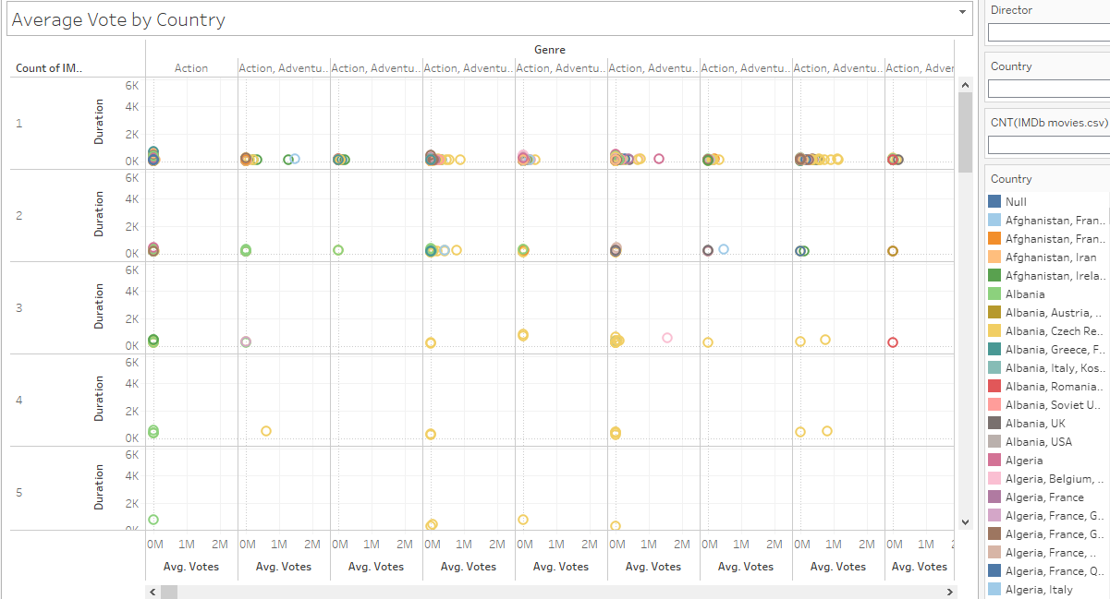
EXPLORATORY DATA ANALYSIS
Figure 2: Top 15 languages with highest movie ratings
Figure 3: Top 15 countries that produces highest rated movies
Figure 3: Genre vs Average Rating
Figure 4 Average Vote by Country

Slide 5
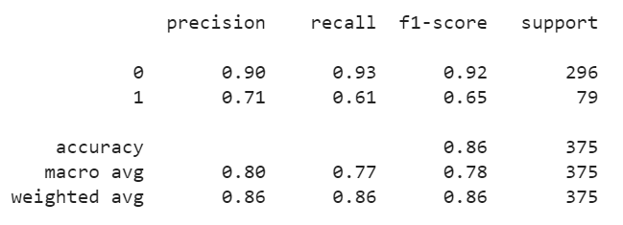
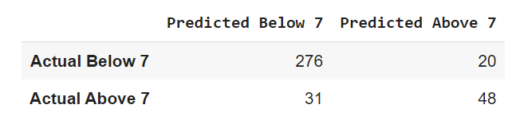
1. Support Vector Machine
We divided our target into two groups:
I. Ratings above 7
II. Ratings below 7

Slide 6
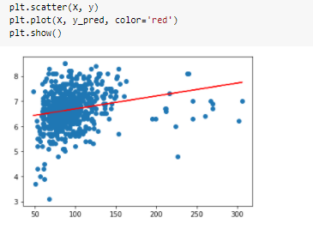
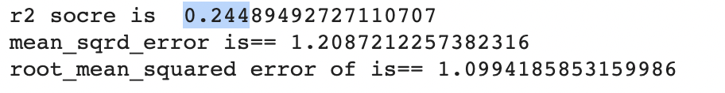
2. Multiple Linear Regression
This is a regression that shows relationship between one dependent variable and two or more independent variables
Used to analyze consumer behaviors and purchase intentions
The reason for the low score would be due to insufficient data relating to the average rating variable and relevance to the problem although the score has increased from previous linear regression model by 20% more.

Slide 7
3 . Deep Learning
This is an advanced form of machine learning that recognizes patterns and features in input data and provides a clear quantitative output.
Used in classification algorithms and regression
Detects complex non-linear relationships
Scalable and effective

Slide 8
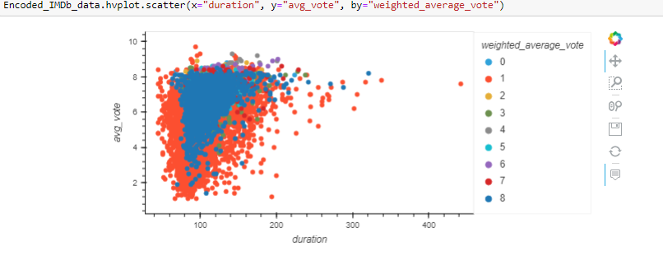
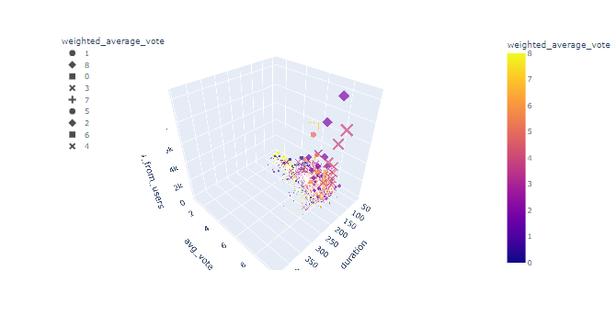
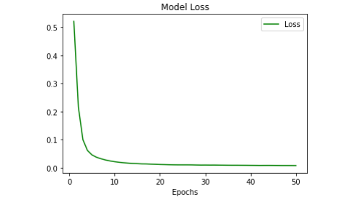
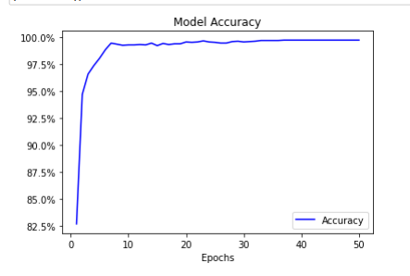
5. Deep Learning cont.

Slide 9
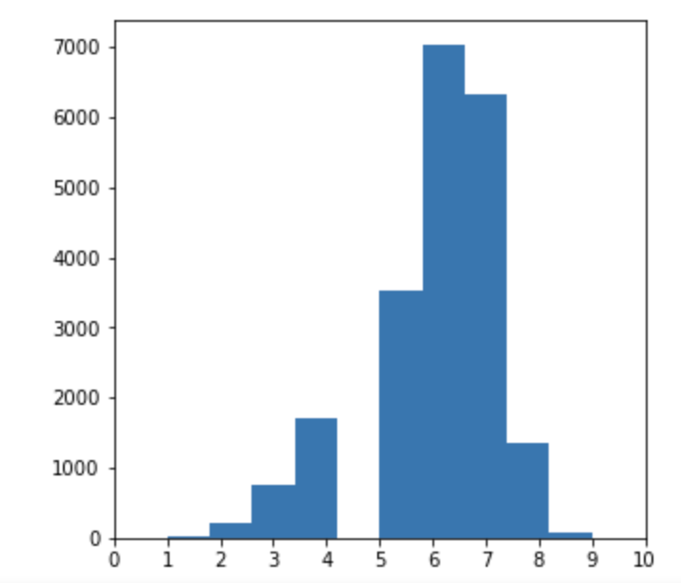
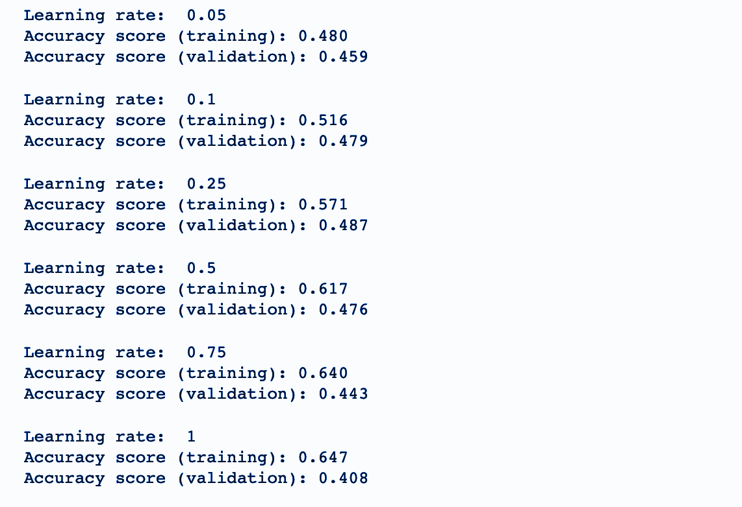
4. Gradient Boosting
Gradient Boosting is a machine learning method that is attractive because of its prediction speed and accuracy.
It relies on the intuition that the best possible next model, combined with the previous model, reduces prediction error.
The model accuracy can be determined by the coefficient of determination the R-squared value or mean squared error(MSE). My prediction model has a mse = 0.9478.

Slide 10
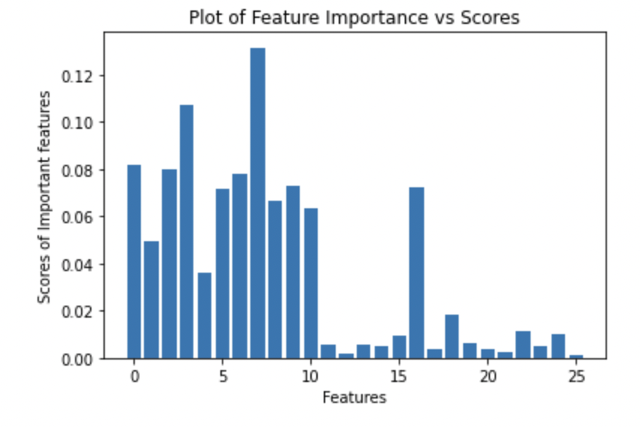
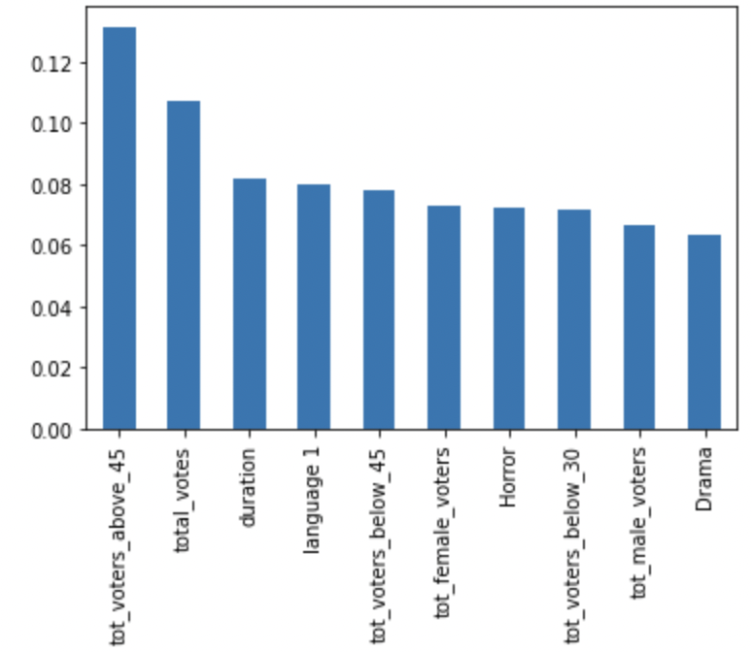
5. Random Forest Regression
Output for Estimators Ranging (200, 800, 100)
[0.49415757514316994,0.4947008957127814, 0.4958920277984976,0.4960607807872609,0.4961116558077189,0.4958916103852188]
Max R2 Score for 700 : 0.496
The reason for the low score would be due to lower correlation between the feature and target (average rating )value, has increased from previous linear regression model by 20% .

Slide 11
Summary of Results for Machine Learning Models
Multiple linear Regression Best R2 Score : 0.244
Support Vector Machine Accuracy : 0.86
Random Forest Regression Best R2 Score : 0.496
Gradient Boosting Accuracy Score :0.48
Deep Learning Accuracy: 0.98

Slide 12
Recommendation for Future Analysis
Sentimental Analysis
Building Movie Recommendations System
What we would have done differently?
Utilized Dataset for Movie Ratings from various movie rating platforms and streaming services like Netflix, Rotten Tomatoes, Metacritic, Google to get more accurate prediction for rating
Including the columns for budget and box office collection to the dataset

Slide 13
Thank You

